Slide 1

Clerk of Session Training
Presbytery of the Peaks

Slide 2
General Role and
Book of Order Requirements
The main thing that a Clerk of Session is responsible for is to maintain, preserve and share the minutes, rolls and registrars of a congregation, including:
  Session Minutes
  Congregational Meeting Minutes
  Minutes of Joint Meetings of Session with Trustees or Deacons
  Baptized Members Roll
  Active Members Roll
  Affiliate Members Roll
  Inactive Members Roll (optional)

Slide 3
General Role and
Book of Order Requirements
  Installed Pastor Register
  Elder Register
  Deacon Register
  Baptism Register
  Marriage Register (optional)

Slide 4
General Role and
Book of Order Requirements
Broadly, the Clerk of Session is also responsible:
  to know the Book of Order
  to know Robert’s Rules
  to send and receive communications on behalf of session, including letters of transfer
  to assist the pastor regarding matters related to session

Slide 5
General Role and
Book of Order Requirements
Other common items that vary by church:
  Newsletter articles
  Assisting the moderator in keeping track of reports and motions for the agenda
  Keeper of the church’s Bylaws, manuals and policies

Slide 6
General Role and
Book of Order Requirements
The Clerk of Session is also responsible for the following reports to Presbytery and GA:
  Annual Session Minutes Review of Previous Year’s Minutes
  Necrology
  Annual Statistical Report
  Clerk’s Annual Questionnaire

Slide 7
Writing Good Minutes
Robert’s Rules guidelines for what to include in minutes:
  General Principles
    Record actions not discussion and not transcription
    Don’t editorialize
  Recording of Motions
    Record the final wording of main motions, and what happened to them (passed, failed, tabled, etc.)
    Record even failed points of order or appeals
    Mover, but not seconder, of motion

Slide 8
Writing Good Minutes
Robert’s Rules (con’t):
  Location of meeting (church name)
  Date
  Type of meeting (stated or called)
  Name of Moderator
  Name of Clerk
  Time you begin and time you adjourn
  Number of votes for and against if voting by ballot

Slide 9
Writing Good Minutes
Robert’s Rules (con’t)
  Declaration of quorum
    It’s your job to declare a quorum. It’s also your job to know what quorum is for your session (varies by each church, and should be in your bylaws or manual).
  When appropriate, election of Clerk and/or Treasurer
  Attendance, including guests
  Approval of agenda
  Approval of the minutes of the previous meeting
    If corrected, don’t include the changes, just note that they were corrected

Slide 10
Writing Good Minutes
Robert’s Rules (con’t)
  Summaries of Oral Reports of: (written reports may be attached to the minutes instead)
    Clerk
      May contain correspondence, announcements, and report of the serving of the Lord’s Supper, in addition to listing of baptisms, marriages, changes in membership rolls.
    Treasurer
    Pastor or other staff
    Committees and Commissions
    Don’t summarize the remarks of a guest speaker

Slide 11
Writing Good Minutes
Robert’s Rules (advanced)
  When selling, encumbering or receiving real property:
    Name, address and legal description of the property;
    Name of buyer/lessee;
    Sale price/terms;
    Loan amount, purpose and terms, including the name of the lender;
    Lease terms and liability insurance;
    Concurrence of presbytery where necessary

Slide 12
Writing Good Minutes
Book of Order Guidelines
  The Book of Order directs that each meeting of a council (eg, your session) begin and end with prayer. The minutes should reflect this.
  Election of Elder Commissioners for Presbytery
    Please record failed attempts
  Reports of Elder Commissioners from Presbytery
  Approval of Communion dates
  Approval of Baptisms and dates
  Examination of new members

Slide 13
Writing Good Minutes
Book of Order Guidelines (con’t)
  Reception of new members by:
    Profession of Faith and Baptism
    Reaffirmation of Faith
    Letter of Transfer
  Removal of members by:
    Transfer
    Inactive
    Request
    Death

Slide 14
Writing Good Minutes
Book of Order Guidelines (con’t)
  Examination and installation/ordination date for incoming Ruling Elders
  Meeting time and agenda of Congregational meetings
  Housing Allowance for Pastoral staff
  Approval of Budget

Slide 15
Writing Good Minutes
Book of Order - Annual Events
  Examination and training of newly ordained Elders and/or Deacons
  Financial Review
  Pastor’s Salary Review
  Review of Insurance
  Church Membership Review

Slide 16
Writing Good Minutes
Tips and Tricks
  Recording minutes is much easier if you write them out ahead of time and just leave the outcomes blank. Eg, you already know what motions are coming from which committees, just not if they’ll be passed or not.
  You’ll want to have a copy of the Minutes Review Sheet as your completing the minutes; this will help you make sure you’ve got everything you need come review time.
  Keep a calendar of events you may want to remind the pastor of for the agenda.
  Use example minutes from someone else as a base

Slide 21
Registers and Rolls
Tips and Best Practices
Rolls can only be changed by the Session, but the clerk maintains them.
There are only 3 rolls required by the Book of Order (notice “Inactive” is not one of them):
  Baptized Members
    People who have been baptized, but not confirmed (made a public profession of faith).
    Record their Name, Date, and Church where their baptism occurred.
    Remove people from this roll once they are confirmed, or once they leave the church

Slide 22
Registers and Rolls
Tips and Best Practices
  Active Members
    Baptized person having made a profession of faith and commitment to their local church.
    Record their Name, Date received, Method of Reception (Baptism/Profession, Reaffirmation, Transfer), Date of removal and method of removal (transfer, death, request of member, lack of activity).
      Unless a member moves, the period of inactivity prior to removal must be at least 2 years, and the session “shall seek to restore members to active participation and shall provide written notice before deleting names due to member inactivity”. You don’t have to remove inactive members.

Slide 23
Registers and Rolls
Tips and Best Practices
  Affiliate Members
    Active member of another church.
      Eg, college student, snowbird, etc
    Must be renewed every 2 years
    Record their Name, Date of Affiliation, Home Church, Date of Renewal and Date of Return to Home Church
  Inactive Members (optional)
    This is no longer a requirement, but if a session would like to keep this roll, there can be advantages: at times when a member would object to having a relative removed from the rolls entirely, for instance.

Slide 24
Registers and Rolls
Tips and Best Practices
Registers Required by the Book of Order:
  Baptisms
    Register of Infant and Adult Baptisms shall include name, parents’ names (if applicable), and date of birth and date of baptism of those being baptized.
  Elders
    Register of Elders shall include each elder’s name, the name of the church in which each was ordained, date of ordination, terms of active service, and record of removals.

Slide 25
Registers and Rolls
Tips and Best Practices
  Deacons
    Register of Deacons shall include each deacon’s name, the name of the church in which each was ordained, date of ordination, terms of active service, and record of removals.
  Pastors
    Register of Pastors shall include the names of pastors, co-pastors, associate pastors, assistant pastors, interim pastors, stated supplies, and parish associates serving the church, with dates of service.

Slide 26
Registers and Rolls
Tips and Best Practices
  Marriages (Optional)
    Prior to 2011, sessions were also required to maintain a register of marriages. If you wish to continue maintaining this register, here is the list of those marriages that are to be recorded:
    Register of Marriages shall include marriages of members of the church, all marriages conducted by the ministerial staff of the church, and all marriages performed on church property

Slide 27
Preservation of Records
(Minutes, Rolls and Registers)
Digital is not good enough – programs change, and they’re sometimes harder to authenticate.
  Creating and accessing records digitally is fine. Storing them digitally is not.
Vinyl binders are bad for long term storage. They give off a gas that degrades records.
Inkjet printers are superior to laser printers for long term record keeping. Most paper is already acid-free.
Make sure the final minutes are signed (by you) and sealed (by the Presbytery)
  I’ll send you a copy of your Minutes Review form with a seal to insert into your minutes.

Slide 28
Preservation of Records
(Minutes, Rolls and Registers)
Records should be:
  Kept in a binder
  Have numbered pages
    This is to prevent insertion of counterfeit pages.
  Blank pages should be marked with a large X, or labeled as intentionally blank.
    This is to prevent insertion of counterfeit pages.
Presbyterian Historical Society Guidelines:
  http://www.history.pcusa.org/services/records-management/records-congregations
  Most everything except detailed financial records is of value.

Slide 29
Preservation of Records
(Minutes, Rolls and Registers)
Minutes permanent
Registers permanent
Annual reports permanent
Bylaws/charters permanent
Incorporation records permanent
Annual budgets permanent
Annual audits permanent
Annual financial statements permanent
Subject files: permanent
correspondence, minutes, or other records surrounding subject matter of continuing administrative or legal value, or comprising information on the mission, vision, and actions of the congregation
Manuals/handbooks permanent
Newspapers/newsletters permanent

Slide 30
Preservation of Records
(Minutes, Rolls and Registers)
Brochures/promotional materials (1 copy) permanent
Photographs permanent
Architectural drawings, plats, plans, blueprints permanent
Wills, bequests permanent
Legal/judicial cases permanent
Loan agreements satisfaction + 20 years
Property appraisals, records of sale 20 years after sale
Personnel records/employee records employment + 7 years
Contracts active + 6 years
Accounts payable 7 years
Accounts payable invoices 3 years
Accounts receivable records 3 years
Bank deposit slips 3 years
Bank statements 7 years

Slide 31
Preservation of Records
(Minutes, Rolls and Registers)
Canceled checks 7 years
Cash receipt records 3 years
Donations (regular, weekly) 7 years
Expense reports 7 years
FICA / W-2 records 7 years
Payroll records 7 years
Petty cash records 7 years
Receipts of purchases 7 years
General/routine correspondence 3 years
Travel plans/arrangements 3 years
Periodic financial statements 2 years
Data for updating Mailing lists 1 year
Invitations 1 year
Meeting notices 1 year
Reference/Resource materials active

Slide 32
Rules of Discipline
The session is the judicial body of complaint against a member of the church, including Ruling Elders (but not Teaching Elders).
If you ever need this, ask the Stated Clerk for resources.
  A great place to start is the Stated Clerk’s Handbook, chapter IV.

Slide 33
Congregational Meetings
Minutes of all congregational meetings shall be included in the session record book along with session minutes in one chronological order.
The installed pastor shall ordinarily moderate all meetings of the congregation.
The clerk of session shall serve as secretary for all meetings of the congregation. If the clerk of session is unable to serve, the congregation shall elect a secretary for that meeting.

Slide 34
Congregational Meetings
The business of a congregational meeting may only include the following:
  electing ruling elders, deacons, nominating committees and trustees;(always allow for nominations from the floor: G2-0401)
  calling an installed pastor, co-pastor, or associate pastor;
  changing existing installed pastoral relationships, eg, approving changes to the terms of call of the pastor or pastors, or requesting, consenting to, or declining to consent to dissolution;
  buying, mortgaging, or selling real property;
  requesting the presbytery to grant an exemption to officer term limits as permitted in the Constitution (G-2.0404).
  approving a plan for the creation of a joint congregational witness, or amending or dissolving the joint congregational witness (G-5.05).

Slide 35
Annual Responsibilities
You have 2 major annual responsibilities to the GA:
  The Annual Statistical Report
    If you need your password, Julie or Robin can help. It will also be coming to you in the mail.
    Deadline is usually mid February.

Slide 36
What is the address for the website to enter my statistics?
The web address is http://oga.pcusa.org/stats.
Where can I find my username and/or password?
Contact Julie or Robin at the presbytery office for information related to your username or password.
My username and password are not working.
Be sure that you are using five (5) numbers for your username. The username for a church is the PIN number. You will need to add leading zero’s if your PIN is fewer than five numbers. Example, you PIN number is 123. The username would be 00123.
The passwords are also case sensitive. The letter O and number zero 0 often look the same, as well as the letter I and the number one 1. If one does not work try the other.
What is the deadline date for entering statistics?
The deadline for entering the statistics is Thursday, February 17, 2022. Contact Robin or Julie at the Presbytery office if you are unable to meet this deadline.
Who do I contact if I have a problem?
Call Julie or Robin at the Presbytery office for immediate help or email OGARecords@pcusa.org for additional help.

Slide 37
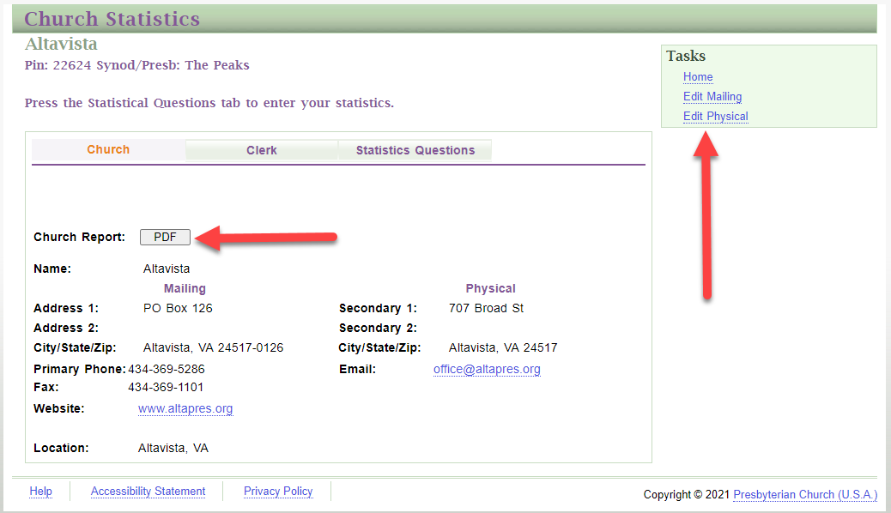

Slide 38
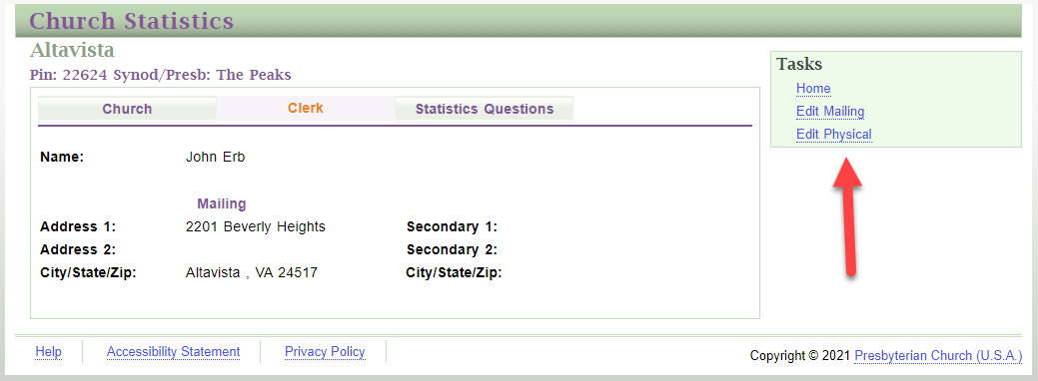

Slide 39
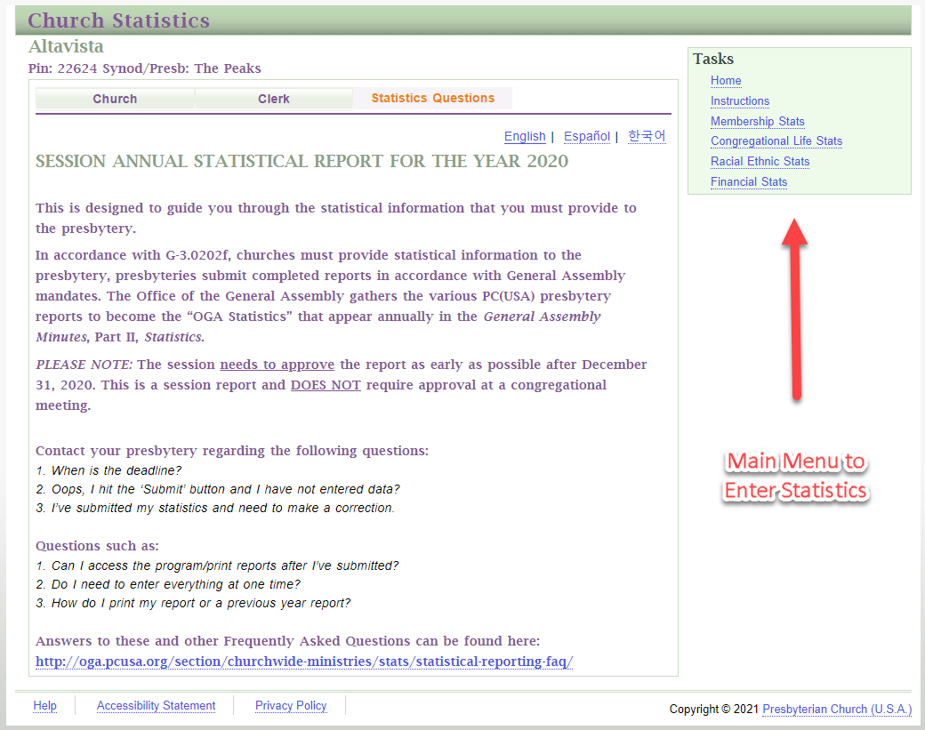

Slide 40
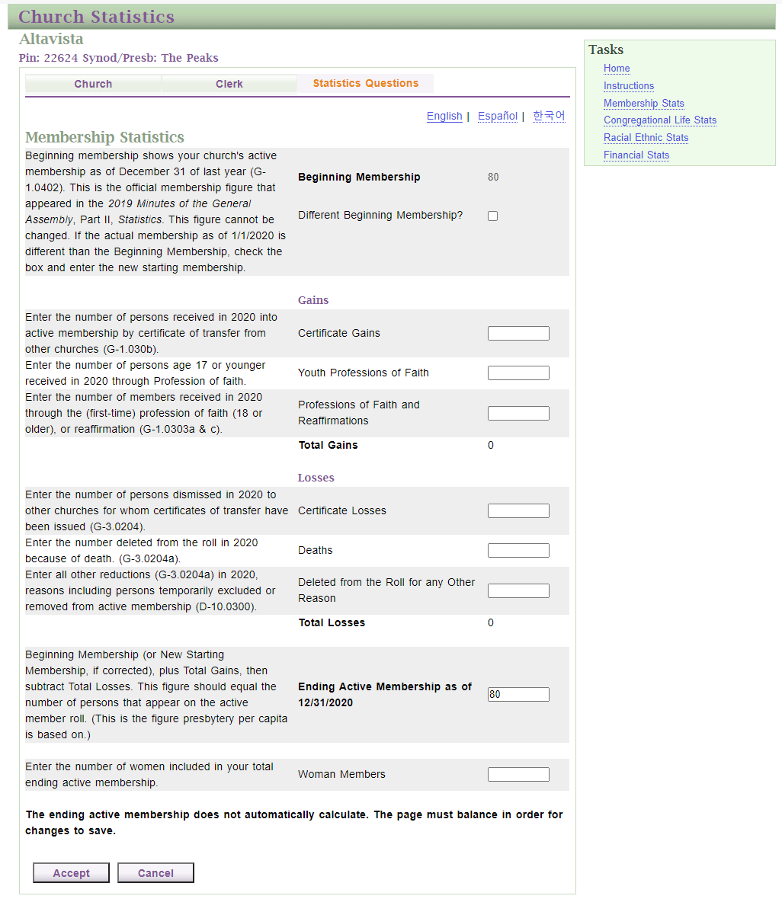

Slide 41
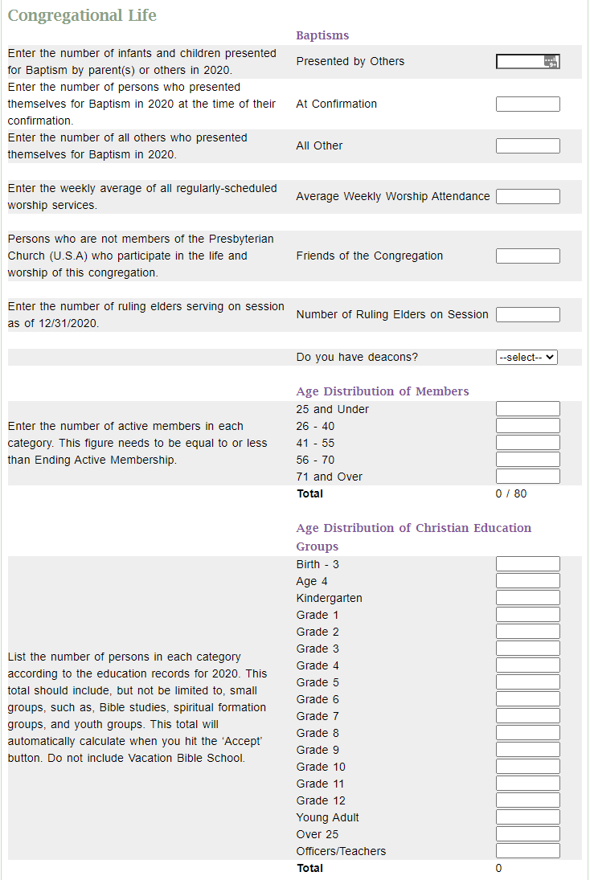

Slide 42
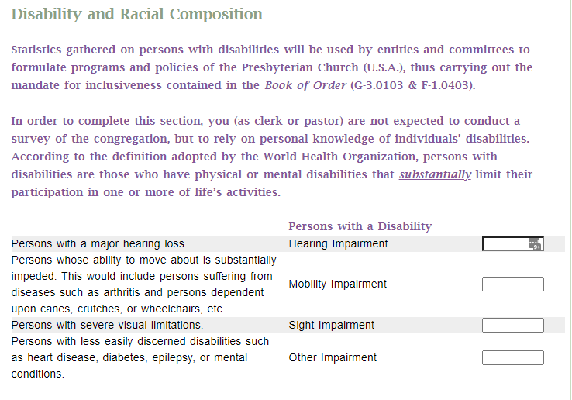

Slide 43
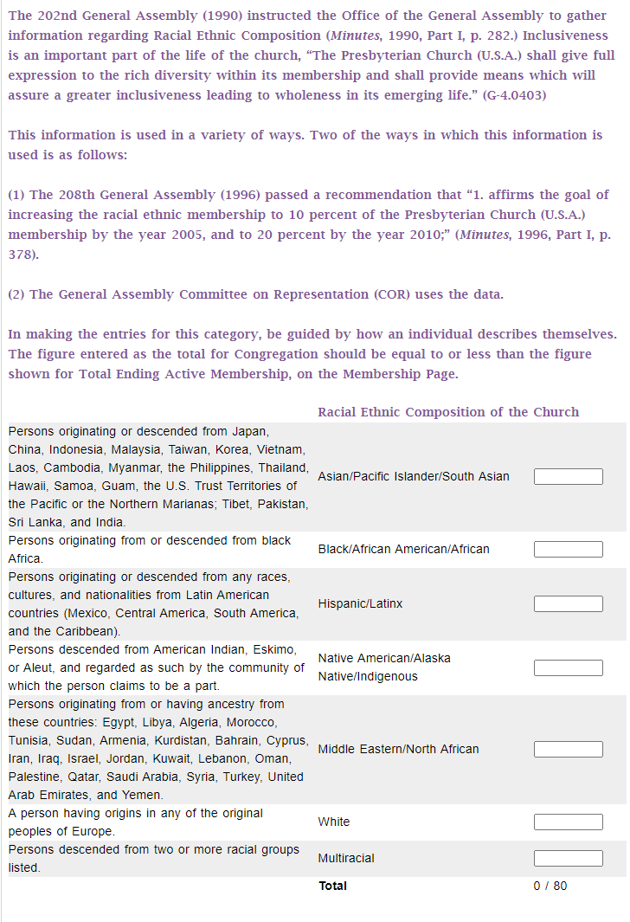

Slide 44
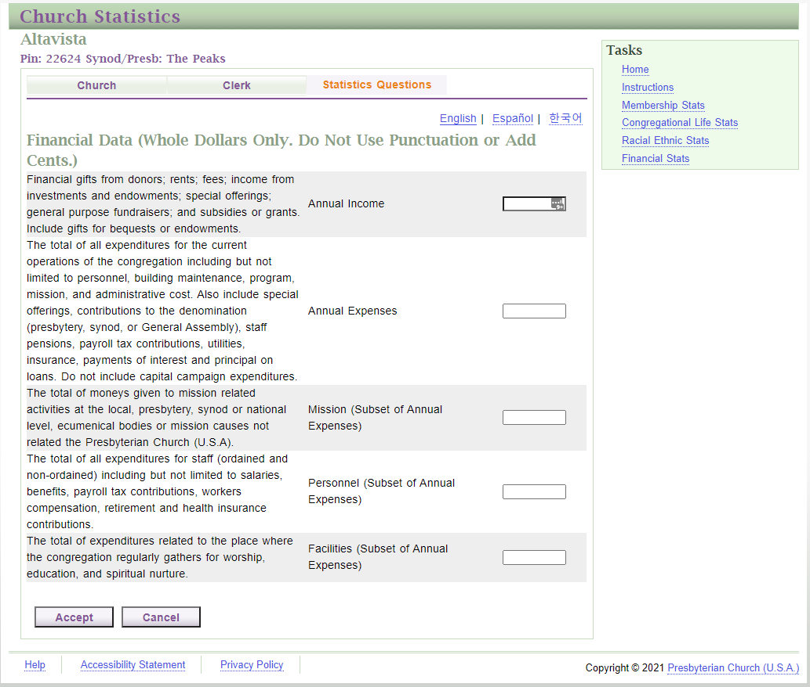

Slide 45
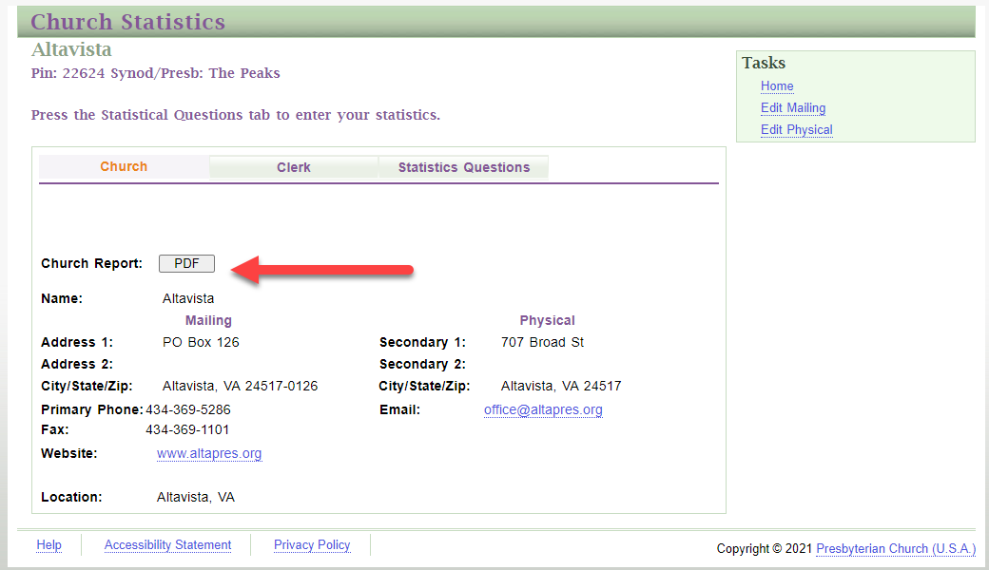

Slide 46
Annual Responsibilities
  Clerk’s Annual Questionnaire
    This is sent out as a link in an email, similar to surveymonkey if you’ve ever used that. This usually comes out towards the end of the year.
    This is a completely different report than the Annual Statistical Report, although they cover some of the same ground. There is much more detailed information in the advanced training.

Slide 47
Annual Responsibilities
You have 2 major annual Presbytery responsibilities:
  the Necrology
    This is a list of the Ruling Elders who have passed away in your church. It will be read at the February meeting of Presbytery during worship.
  Session Minutes Review
    This is also a great guideline for creation of minutes during the year

Slide 54
Common Questions
Who can serve as Clerk of Session?
  GA (1988, 137, 12.187, Com. 4-88): An elder, not currently active on session, may serve as clerk of session.
Is the Pastor a member of Session?
  Yes, all installed Teaching Elders are full members of Session, including voice and vote. (G-3.0201)

Slide 55
Common Questions
Trust Clause Opt Out:
  The trust clause opt out refers to a period of time just after the formation of the PC(USA) where churches of the old PC(US) could opt to remain under their prior rules for who makes decisions about the building.
  The confusion lies in what the old rules say:
    They do not say that a church owns its own property and can leave the denomination whenever it likes.
    They do say that a church, not the Presbytery, is the one that gets to make decisions about the church property.

Slide 56
Common Questions
Additionally, I believe it’s also widely unknown that Presbytery permission is required if you lease any portion of your church building, or any property owned by the church at all for more than 5 years (eg, an old manse):
  G-4.0206 Selling, Encumbering, or Leasing Church Property
  a. Selling or Encumbering Congregational Property
  A congregation shall not sell, mortgage, or otherwise encumber any of its real property and it shall not acquire real property subject to an encumbrance or condition without the written permission of the presbytery transmitted through the session of the congregation.
  b. Leasing Congregational Property
  A congregation shall not lease its real property used for purposes of worship, or lease for more than five years any of its other real property, without the written permission of the presbytery transmitted through the session of the congregation.

Slide 57
Q&A

